Slide 1




SRG evolution of large-cutoff chiral effective field theory interactions
Anthony Tropiano¹, Scott Bogner², Dick Furnstahl¹
¹Ohio State University, ²Michigan State University
APS DNP Meeting - Waikoloa Village, Hawaii
October 24, 2018

Slide 2
Motivation
Revisit problem studied by Wendt et al.¹
SRG evolve non-local chiral potentials at leading-order and high cutoffs
Since then there has been an explosion of chiral potentials
At leading-order chiral effective field theory is cutoff dependent
Does the SRG evolve these potentials to a decoupled, cutoff independent form?
¹K.A. Wendt, R.J. Furnstahl, R.J. Perry, Phys. Rev. C 83, 034005 (2011)

Slide 3
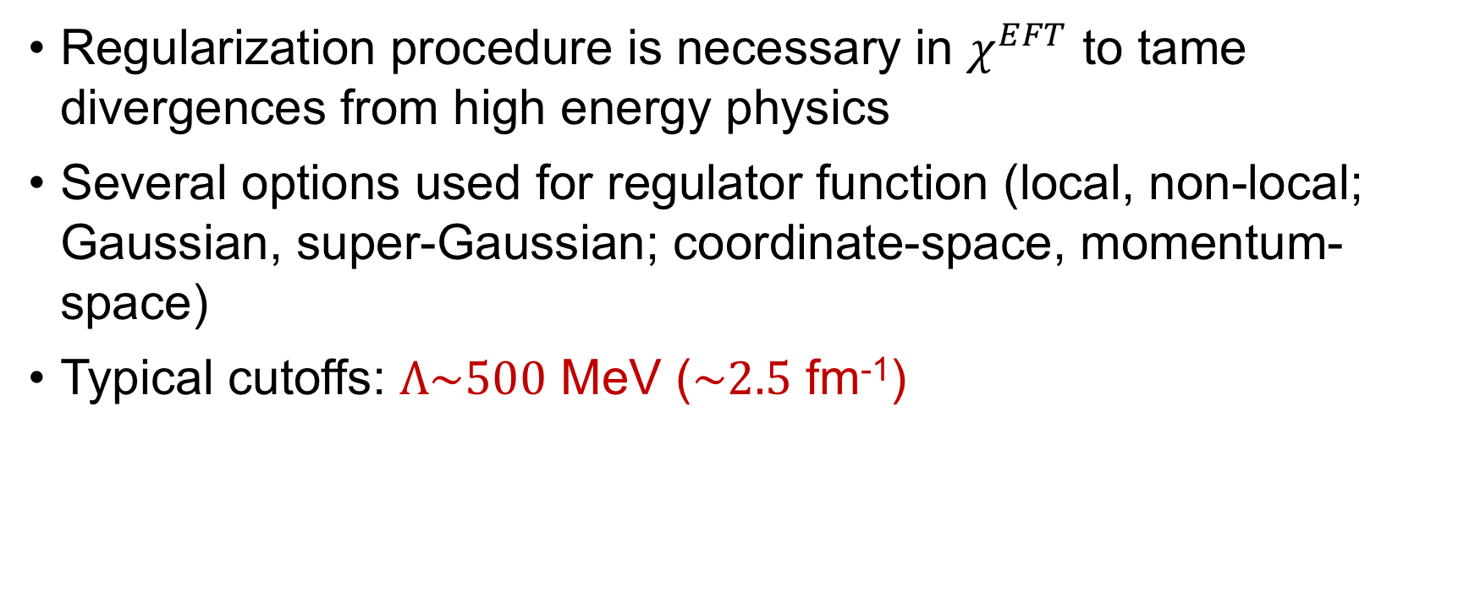
Chiral effective field theory
Regularization procedure is necessary in $χ^{EFT}$ to tame divergences from high energy physics
Several options used for regulator function (local, non-local; Gaussian, super-Gaussian; coordinate-space, momentum-space)
Typical cutoffs: $Λ\sim 500$ MeV ($\sim 2.5$ fm⁻¹)

Slide 4
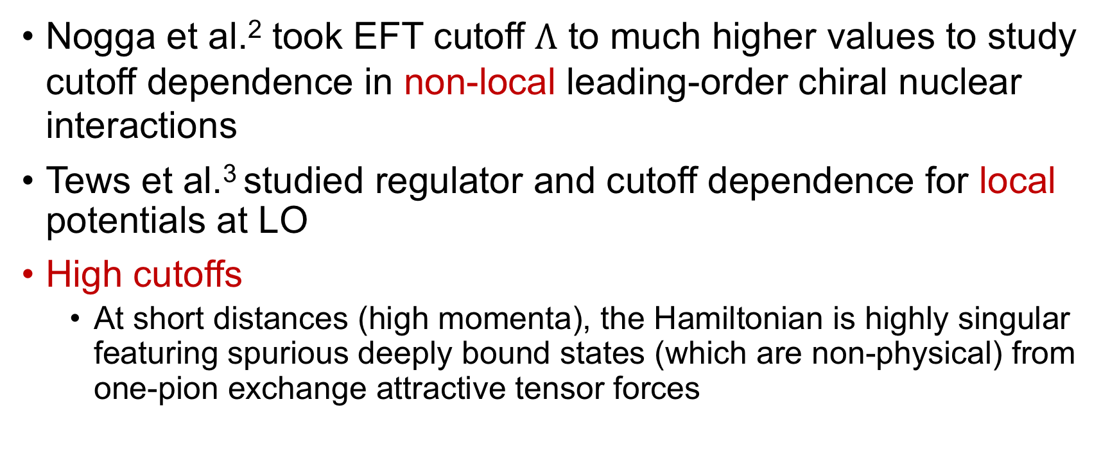
Chiral effective field theory
Nogga et al.² took EFT cutoff $Λ$ to much higher values to study cutoff dependence in non-local leading-order chiral nuclear interactions
Tews et al.³ studied regulator and cutoff dependence for local potentials at LO
High cutoffs
At short distances (high momenta), the Hamiltonian is highly singular featuring spurious deeply bound states (which are non-physical) from one-pion exchange attractive tensor forces
²A. Nogga, R.G.E. Timmermans, and U. van Kolck, Phys. Rev. C 72, 054006 (2005), ³I. Tews, L. Huth, and A. Schwenk, Phys. Rev. C 98, 024001 (2018)

Slide 5
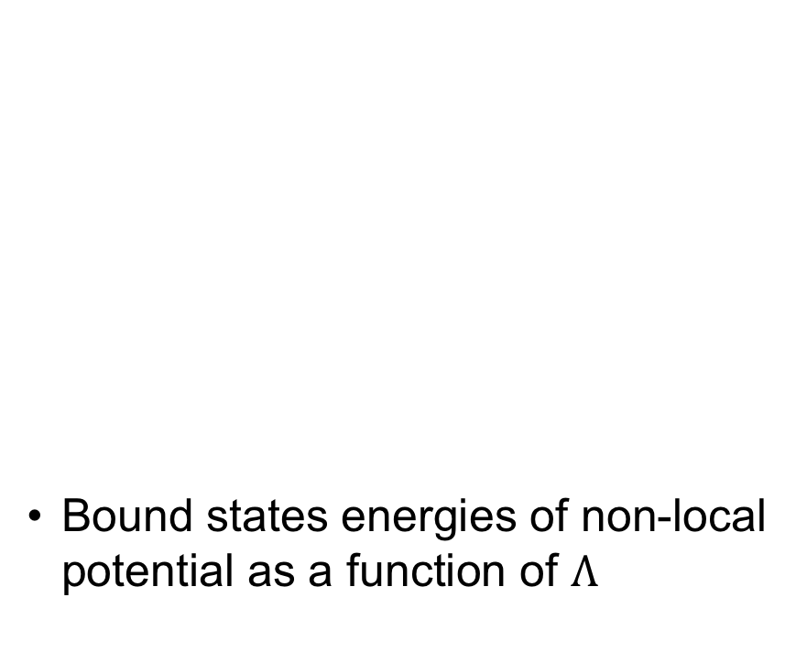
Chiral effective field theory
Spurious deeply bound states
From EFT perspective, deeply bound states are outside of range of EFT
In practice, do they corrupt low-momentum physics?
Here we consider non-local and semi-local chiral potentials at LO in the ³S₁-³D₁ channel
Bound states energies of non-local potential as a function of $Λ$

Slide 6
Chiral effective field theory
Spurious
Spurious deeply bound states
From EFT perspective, deeply bound states are outside of range of EFT
In practice, do they corrupt low-momentum physics?
Here we consider non-local and semi-local chiral potentials at LO in the ³S₁-³D₁ channel
Bound states energies of non-local potential as a function of $Λ$
Deuteron

Slide 7
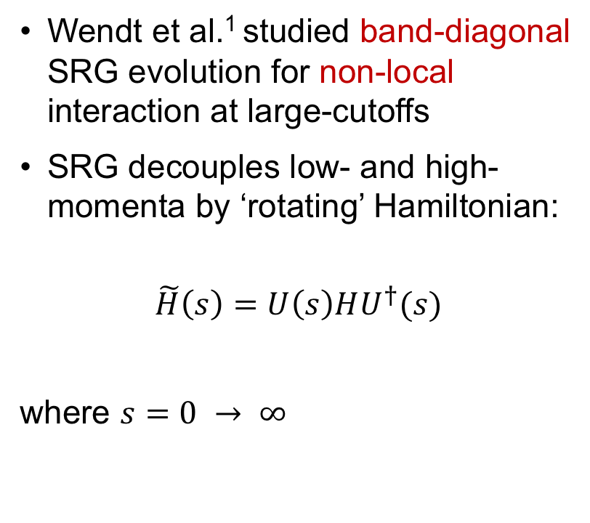
SRG for LO chiral EFT with high cutoffs
Wendt et al.¹ studied band-diagonal SRG evolution for non-local interaction at large-cutoffs
SRG decouples low- and high-momenta by ‘rotating’ Hamiltonian:
$$\tilde{H}\left(s\right)=U\left(s\right)HU^{†}(s)$$
where $s=0 → ∞$
¹K.A. Wendt, R.J. Furnstahl, R.J. Perry, Phys. Rev. C 83, 034005 (2011)

Slide 8
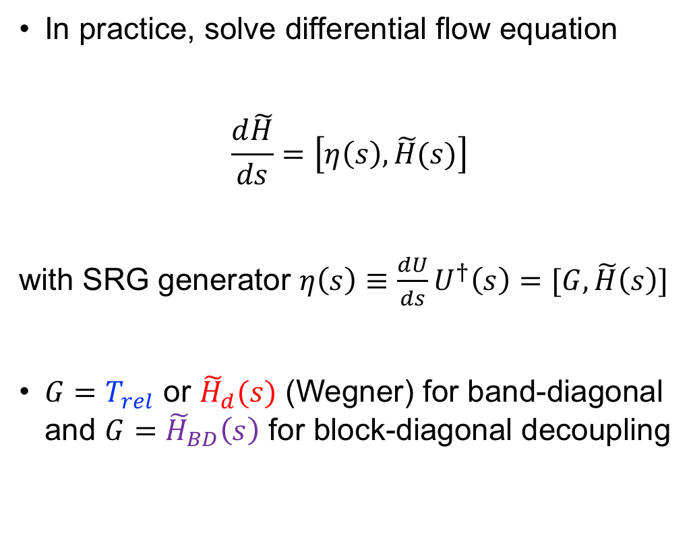
SRG for LO chiral EFT with high cutoffs
Wendt et al.¹ studied band-diagonal SRG evolution for non-local interaction at large-cutoffs
SRG decouples low- and high-momenta by ‘rotating’ Hamiltonian:
$$\tilde{H}\left(s\right)=U\left(s\right)HU^{†}(s)$$
where $s=0 → ∞$
In practice, solve differential flow equation
$$\frac{d\tilde{H}}{ds}=\left[η\left(s\right),\tilde{H}(s)\right]$$
with SRG generator $η\left(s\right)≡\frac{dU}{ds}U^{†}\left(s\right)=[G,\tilde{H}\left(s\right)]$
$G=T_{rel}$ or ${\tilde{H}}_{d}(s)$ (Wegner) for band-diagonal and $G={\tilde{H}}_{BD}\left(s\right)$ for block-diagonal decoupling
¹K.A. Wendt, R.J. Furnstahl, R.J. Perry, Phys. Rev. C 83, 034005 (2011)

Slide 9
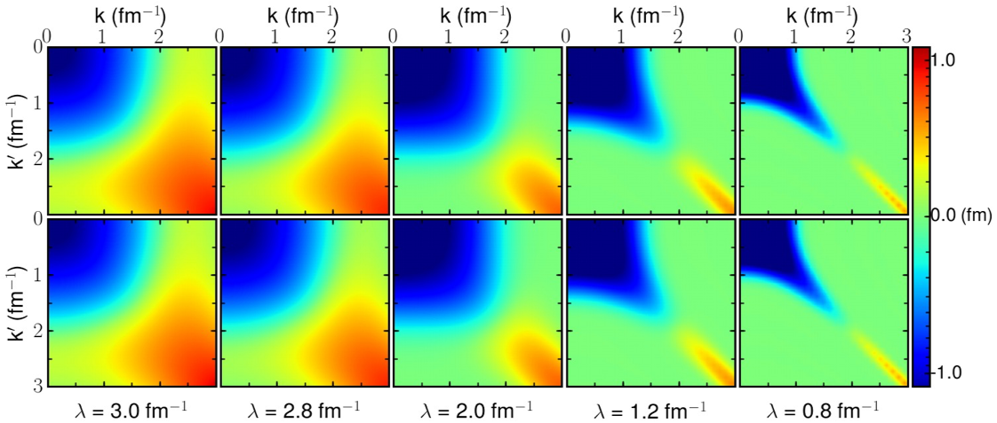
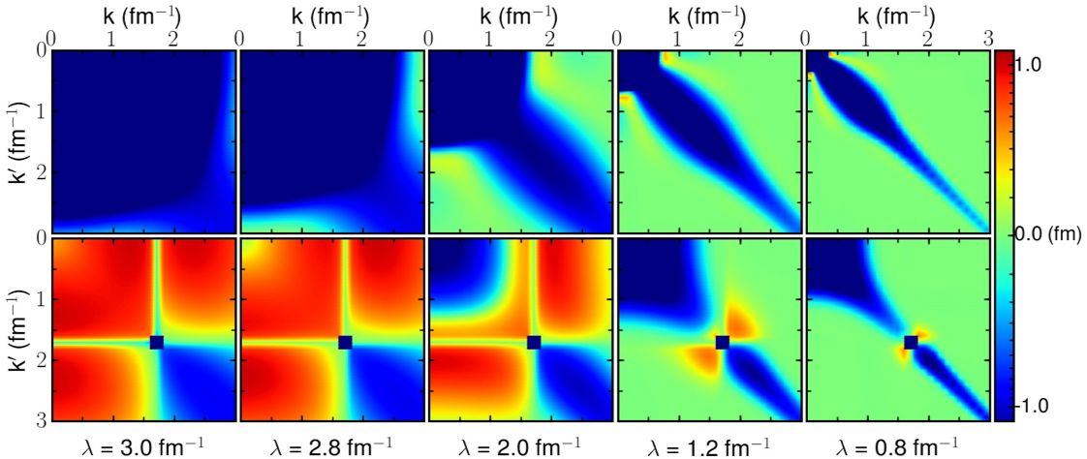
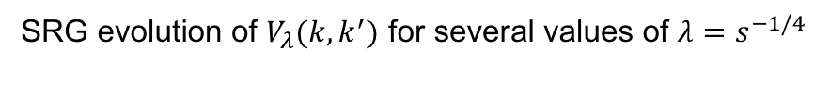
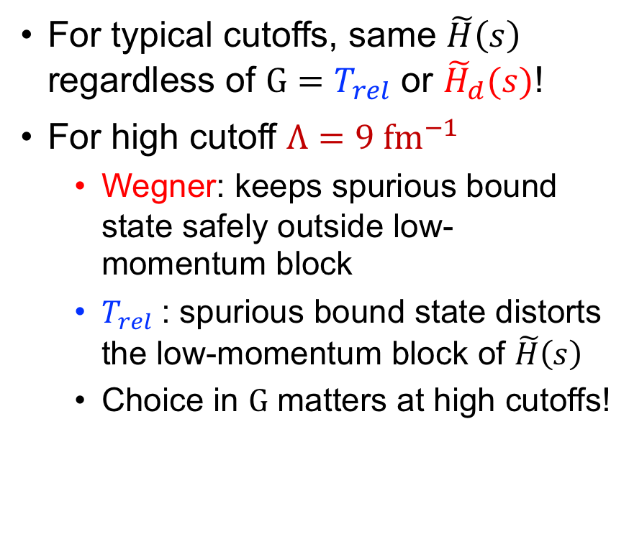
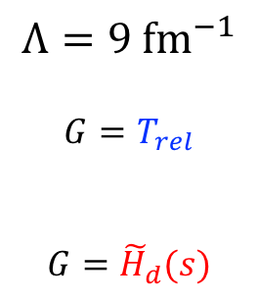
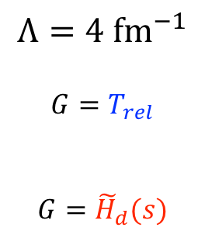
SRG for LO chiral EFT with high cutoffs
$$Λ=4 {fm}^{−1}$$
$$G=T_{rel}$$
$$G={\tilde{H}}_{d}(s)$$
For typical cutoffs, same $\tilde{H}\left(s\right)$ regardless of $G=T_{rel}$ or ${\tilde{H}}_{d}(s)$!
For high cutoff $Λ=9 {fm}^{−1}$
Wegner: keeps spurious bound state safely outside low-momentum block
$T_{rel}$: spurious bound state distorts the low-momentum block of $\tilde{H}\left(s\right)$
Choice in $G$ matters at high cutoffs!
$$Λ=9 {fm}^{−1}$$
$$G=T_{rel}$$
$$G={\tilde{H}}_{d}(s)$$
SRG evolution of $V_{λ}(k,k^{′})$ for several values of $λ=s^{−1/4}$
Figure from K.A. Wendt, R.J. Furnstahl, R.J. Perry, Phys. Rev. C 83, 034005 (2011)

Slide 10
SRG for LO chiral EFT with high cutoffs
$$Λ=4 {fm}^{−1}$$
$$G=T_{rel}$$
$$G={\tilde{H}}_{d}(s)$$
For typical cutoffs, same $\tilde{H}\left(s\right)$ regardless of $G=T_{rel}$ or ${\tilde{H}}_{d}(s)$!
For high cutoff $Λ=9 {fm}^{−1}$
Wegner: keeps spurious bound state safely outside low-momentum block
$T_{rel}$: spurious bound state distorts the low-momentum block of $\tilde{H}\left(s\right)$
Choice in $G$ matters at high cutoffs!
These are consistent low-momentum matrix elements!
$$Λ=9 {fm}^{−1}$$
$$G=T_{rel}$$
$$G={\tilde{H}}_{d}(s)$$
SRG evolution of $V_{λ}(k,k^{′})$ for several values of $λ=s^{−1/4}$
Figure from K.A. Wendt, R.J. Furnstahl, R.J. Perry, Phys. Rev. C 83, 034005 (2011)

Slide 11
SRG for LO chiral EFT with high cutoffs
$$Λ=4 {fm}^{−1}$$
$$G=T_{rel}$$
$$G={\tilde{H}}_{d}(s)$$
For typical cutoffs, same $\tilde{H}\left(s\right)$ regardless of $G=T_{rel}$ or ${\tilde{H}}_{d}(s)$!
For high cutoff $Λ=9 {fm}^{−1}$
Wegner: keeps spurious bound state safely outside low-momentum block
$T_{rel}$: spurious bound state distorts the low-momentum block of $\tilde{H}\left(s\right)$
Choice in $G$ matters at high cutoffs!
High-momentum mixed with low-momentum matrix elements!
$$Λ=9 {fm}^{−1}$$
$$G=T_{rel}$$
$$G={\tilde{H}}_{d}(s)$$
SRG evolution of $V_{λ}(k,k^{′})$ for several values of $λ=s^{−1/4}$
Figure from K.A. Wendt, R.J. Furnstahl, R.J. Perry, Phys. Rev. C 83, 034005 (2011)

Slide 12
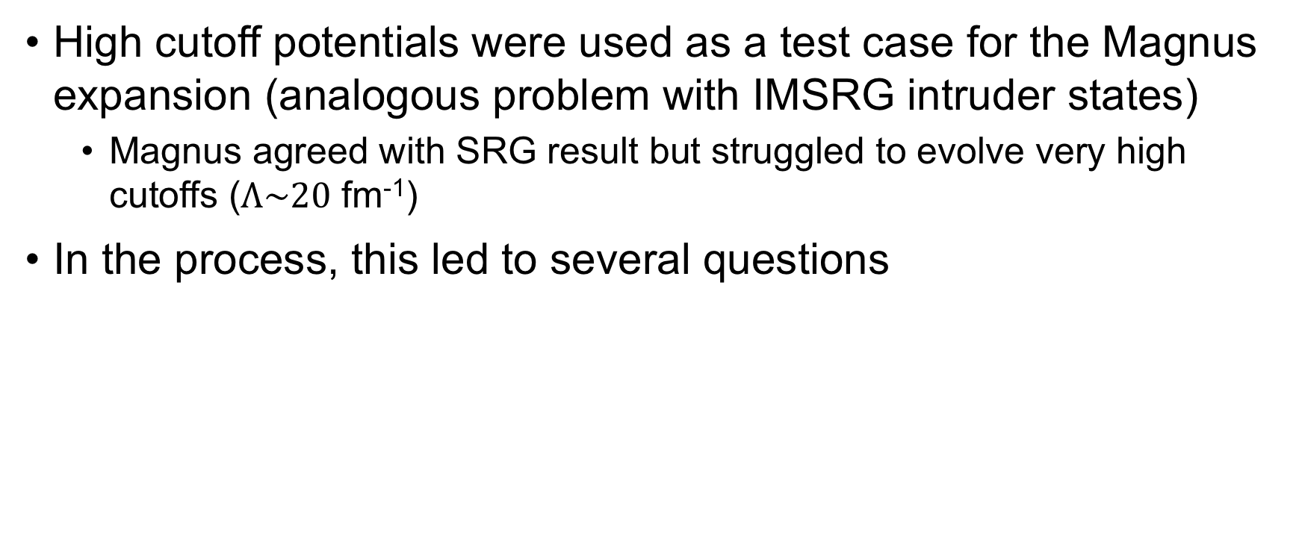
Motivation
High cutoff potentials were used as a test case for the Magnus expansion (analogous problem with IMSRG intruder states)
Magnus agreed with SRG result but struggled to evolve very high cutoffs ($Λ\sim 20$ fm⁻¹)
In the process, this led to several questions

Slide 13
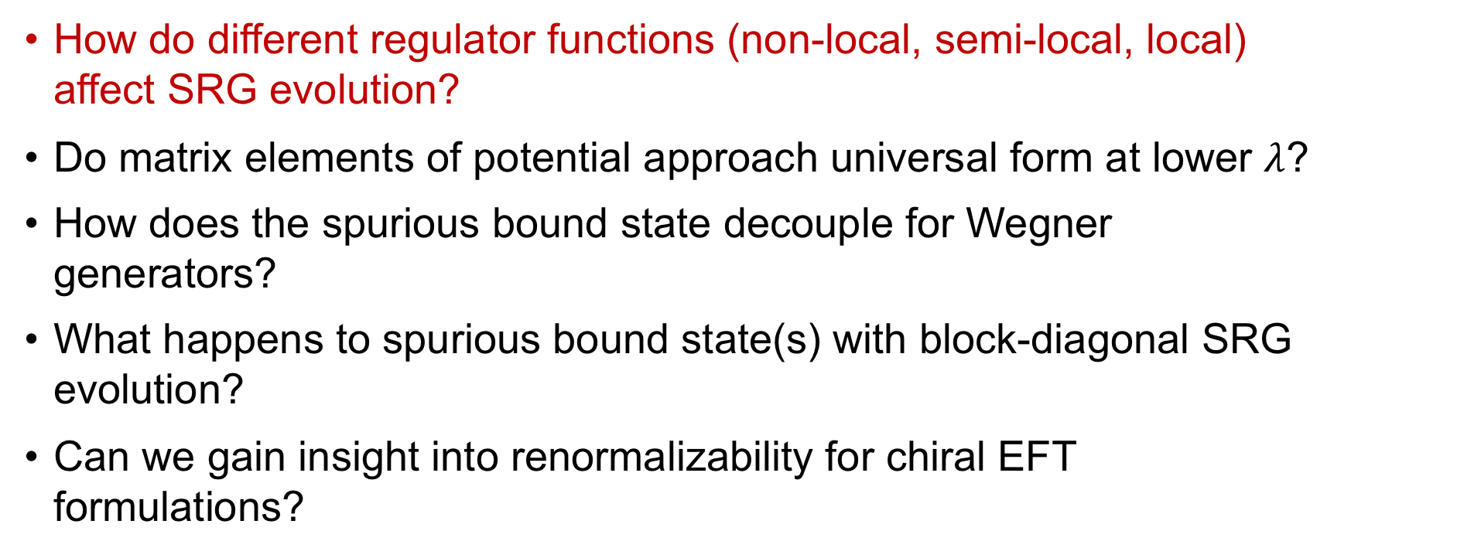
Motivation
How do different regulator functions (non-local, semi-local, local) affect SRG evolution?
Do matrix elements of potential approach universal form at lower $λ$?
How does the spurious bound state decouple for Wegner generators?
What happens to spurious bound state(s) with block-diagonal SRG evolution?
Can we gain insight into renormalizability for chiral EFT formulations?

Slide 14
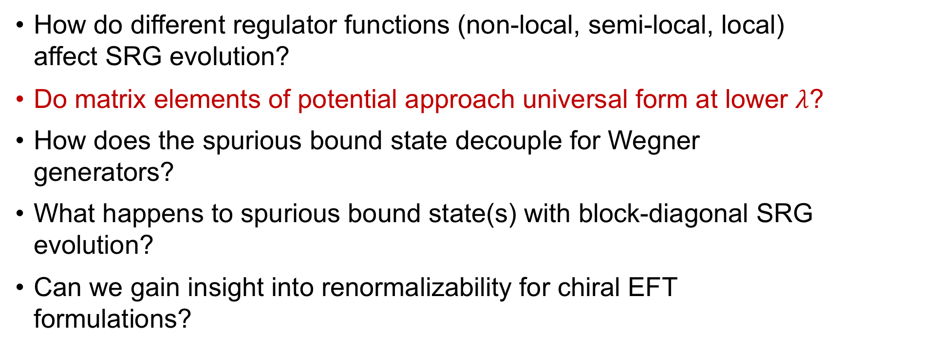
Motivation
How do different regulator functions (non-local, semi-local, local) affect SRG evolution?
Do matrix elements of potential approach universal form at lower $λ$?
How does the spurious bound state decouple for Wegner generators?
What happens to spurious bound state(s) with block-diagonal SRG evolution?
Can we gain insight into renormalizability for chiral EFT formulations?

Slide 15
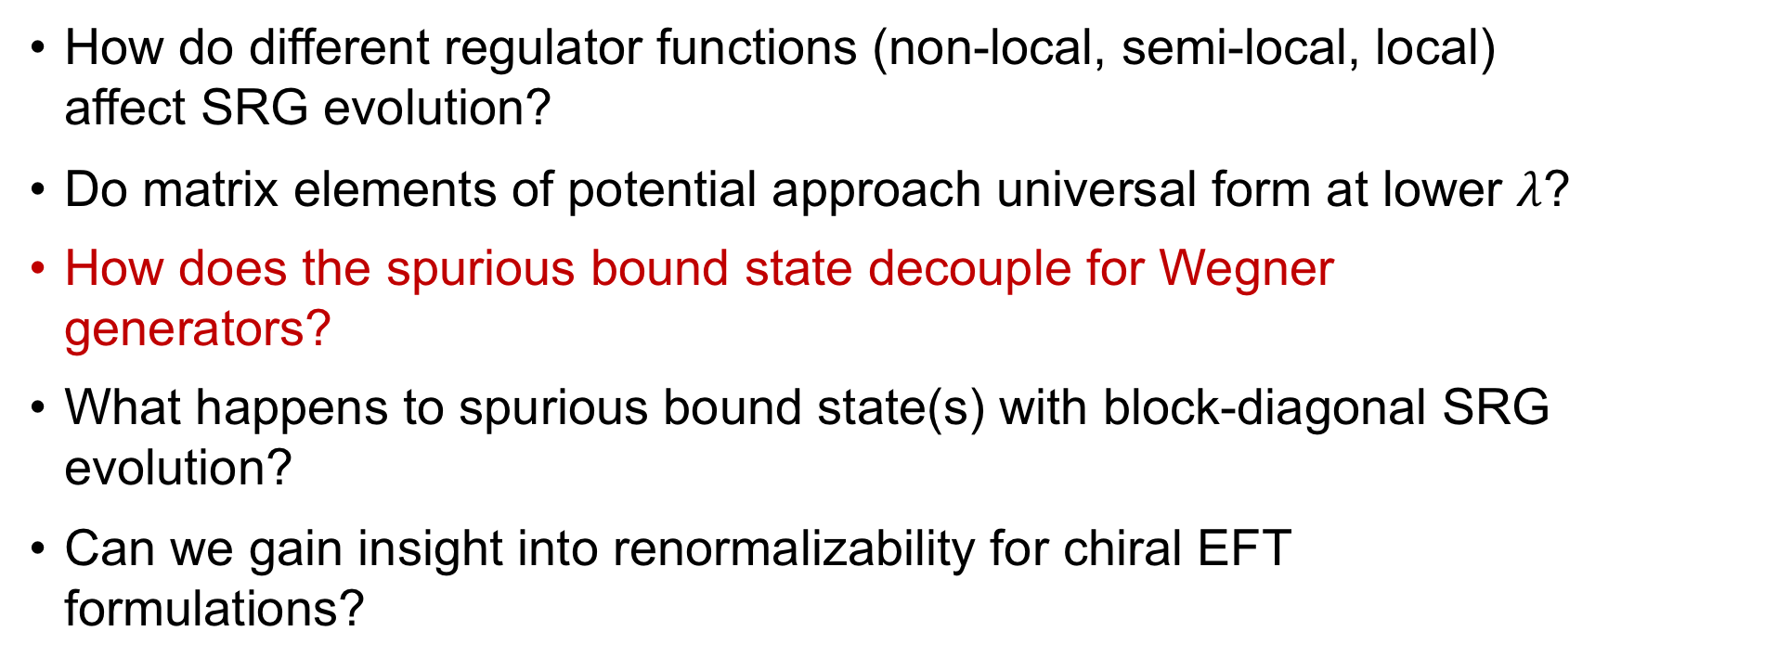
Motivation
How do different regulator functions (non-local, semi-local, local) affect SRG evolution?
Do matrix elements of potential approach universal form at lower $λ$?
How does the spurious bound state decouple for Wegner generators?
What happens to spurious bound state(s) with block-diagonal SRG evolution?
Can we gain insight into renormalizability for chiral EFT formulations?

Slide 16
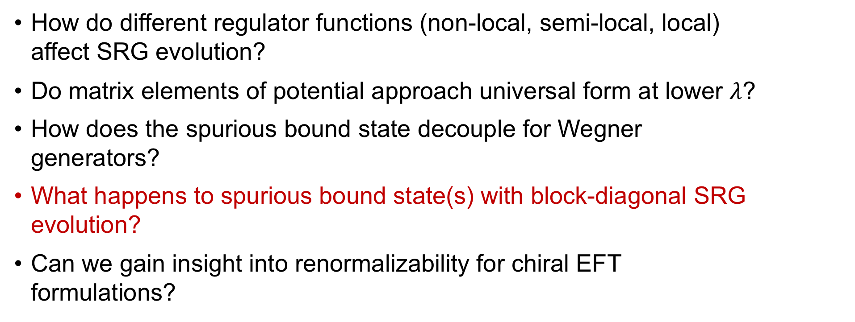
Motivation
How do different regulator functions (non-local, semi-local, local) affect SRG evolution?
Do matrix elements of potential approach universal form at lower $λ$?
How does the spurious bound state decouple for Wegner generators?
What happens to spurious bound state(s) with block-diagonal SRG evolution?
Can we gain insight into renormalizability for chiral EFT formulations?

Slide 17
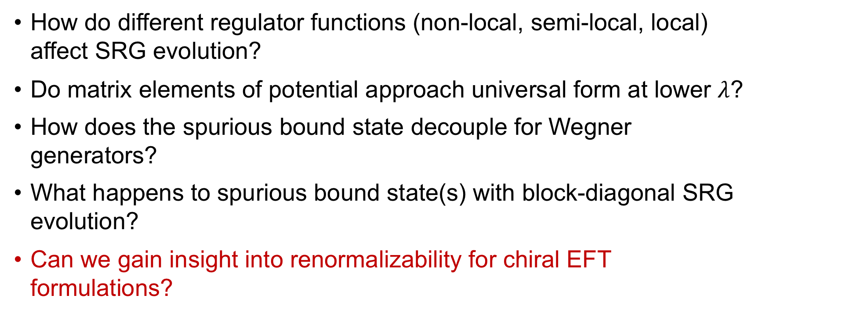
Motivation
How do different regulator functions (non-local, semi-local, local) affect SRG evolution?
Do matrix elements of potential approach universal form at lower $λ$?
How does the spurious bound state decouple for Wegner generators?
What happens to spurious bound state(s) with block-diagonal SRG evolution?
Can we gain insight into renormalizability for chiral EFT formulations?

Slide 18
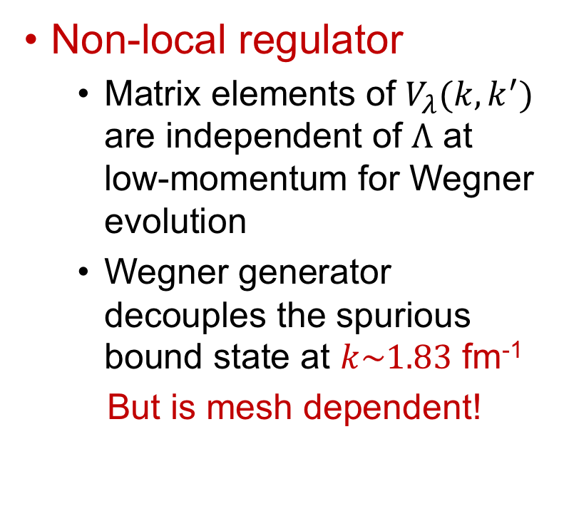
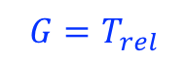
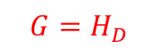
Band-diagonal evolution
Non-local regulator
Matrix elements of $V_{λ}(k,k^{′})$ are independent of $Λ$ at low-momentum for Wegner evolution
Wegner generator decouples the spurious bound state at $k\sim 1.83$ fm⁻¹
But is mesh dependent!
$$G=H_{D}$$
$$G=T_{rel}$$

Slide 19
Band-diagonal evolution
Cutoff independent!
Non-local regulator
Matrix elements of $V_{λ}(k,k^{′})$ are independent of $Λ$ at low-momentum for Wegner evolution
Wegner generator decouples the spurious bound state at $k\sim 1.83$ fm⁻¹
But is mesh dependent!
Decoupled spurious bound state
$$G=H_{D}$$
Cutoff dependent!
$$G=T_{rel}$$

Slide 20
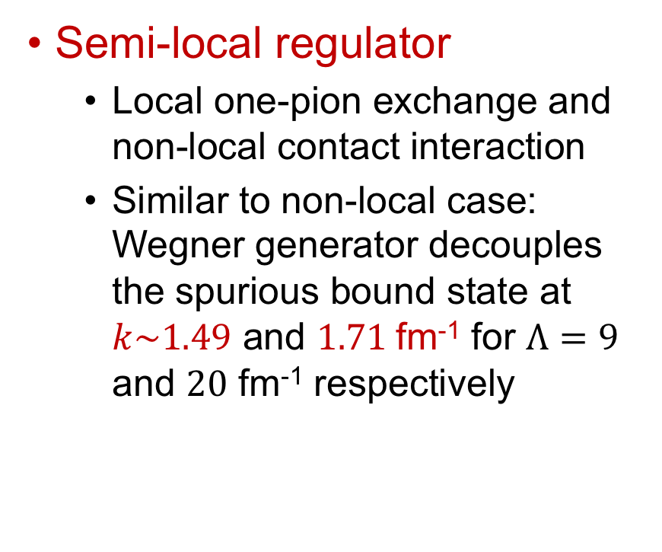
Band-diagonal evolution
Semi-local regulator
Local one-pion exchange and non-local contact interaction
Similar to non-local case: Wegner generator decouples the spurious bound state at $k\sim 1.49$ and $1.71$fm⁻¹ for $Λ=9$ and $20$ fm⁻¹ respectively

Slide 21
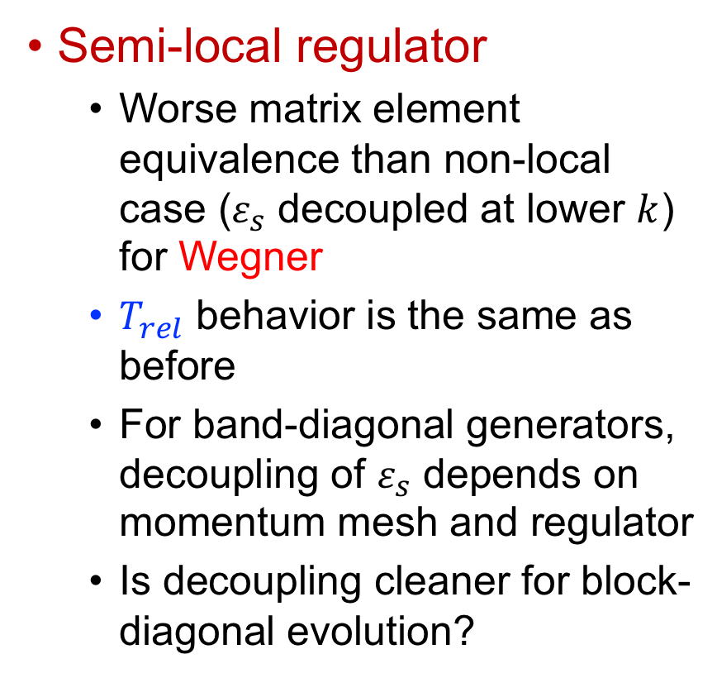
Band-diagonal evolution
Semi-local regulator
Worse matrix element equivalence than non-local case ($ε_{s}$ decoupled at lower $k$) for Wegner
$T_{rel}$ behavior is the same as before
For band-diagonal generators, decoupling of $ε_{s}$ depends on momentum mesh and regulator
Is decoupling cleaner for block-diagonal evolution?

Slide 22
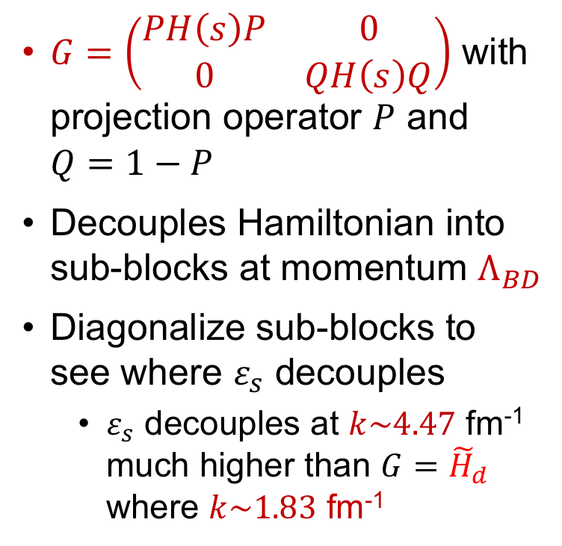
Block-diagonal evolution
$G=\left(\begin{matrix}PH\left(s\right)P & 0 \\ 0 & QH\left(s\right)Q\end{matrix}\right)$ with projection operator $P$ and $Q=1−P$
Decouples Hamiltonian into sub-blocks at momentum $Λ_{BD}$
Diagonalize sub-blocks to see where $ε_{s}$ decouples
$ε_{s}$ decouples at $k\sim 4.47$ fm⁻¹ much higher than ${G=\tilde{H}}_{d}$ where $k\sim 1.83$ fm⁻¹
Non-local interaction

Slide 23
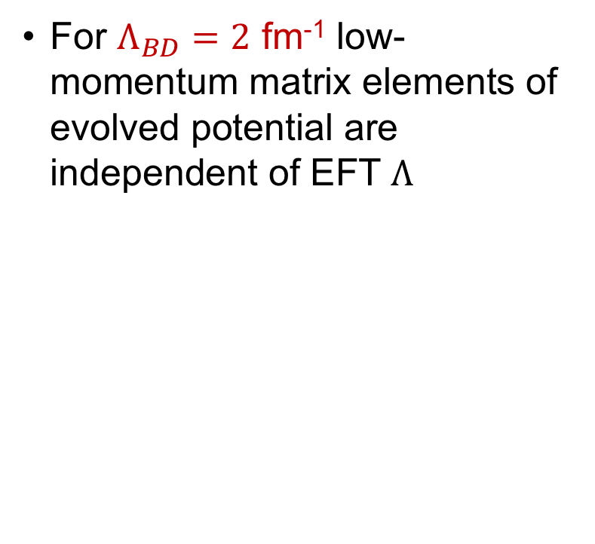
Block-diagonal evolution
For $Λ_{BD}=2$ fm⁻¹ low-momentum matrix elements of evolved potential are independent of EFT $Λ$
Cutoff independent matrix elements
Non-local interaction

Slide 24
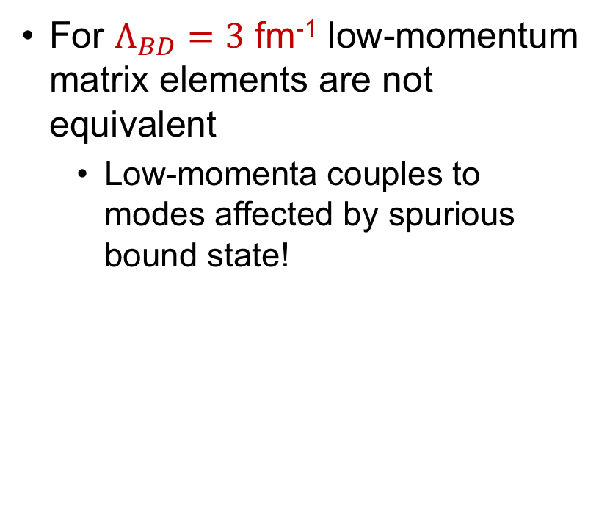
Block-diagonal evolution
For $Λ_{BD}=3$ fm⁻¹ low-momentum matrix elements are not equivalent
Low-momenta couples to modes affected by spurious bound state!
Cutoff dependent matrix elements!
Non-local interaction

Slide 25
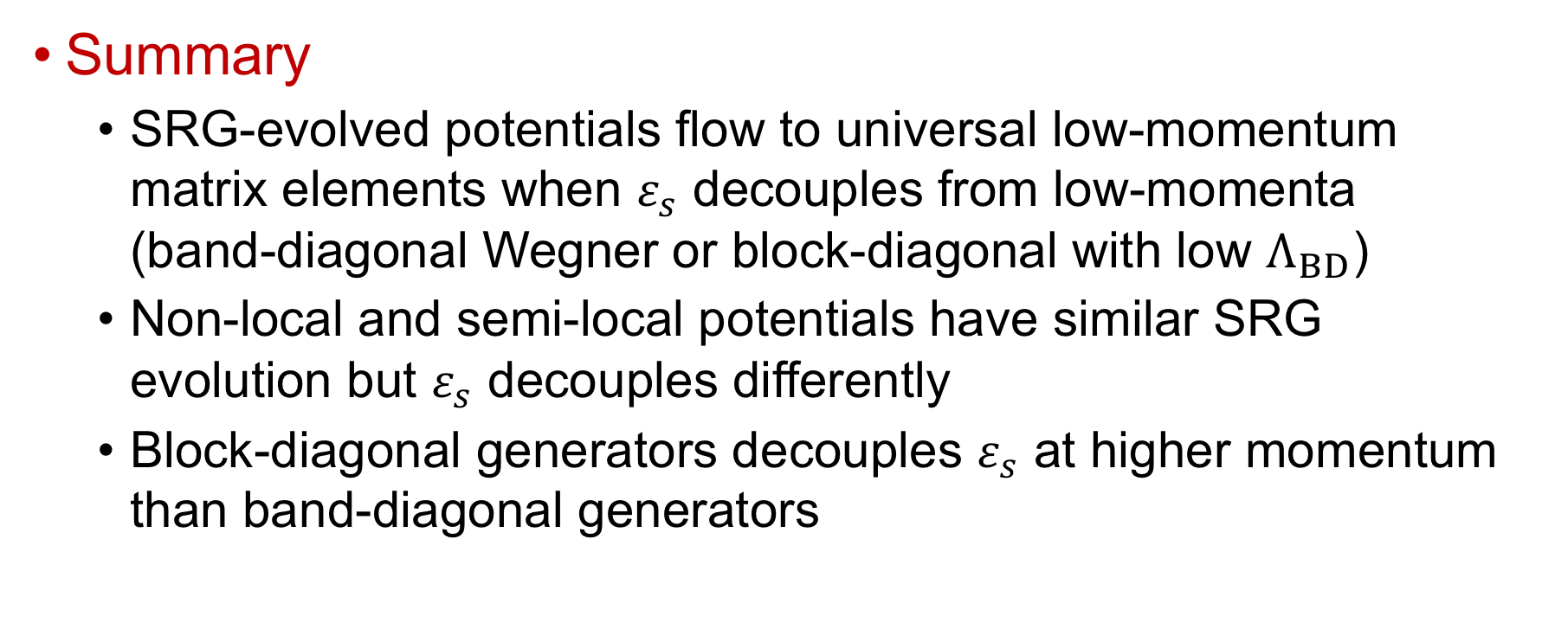
Conclusion
Summary
SRG-evolved potentials flow to universal low-momentum matrix elements when $ε_{s}$ decouples from low-momenta (band-diagonal Wegner or block-diagonal with low $Λ_{BD}$)
Non-local and semi-local potentials have similar SRG evolution but $ε_{s}$ decouples differently
Block-diagonal generators decouples $ε_{s}$ at higher momentum than band-diagonal generators

Slide 26
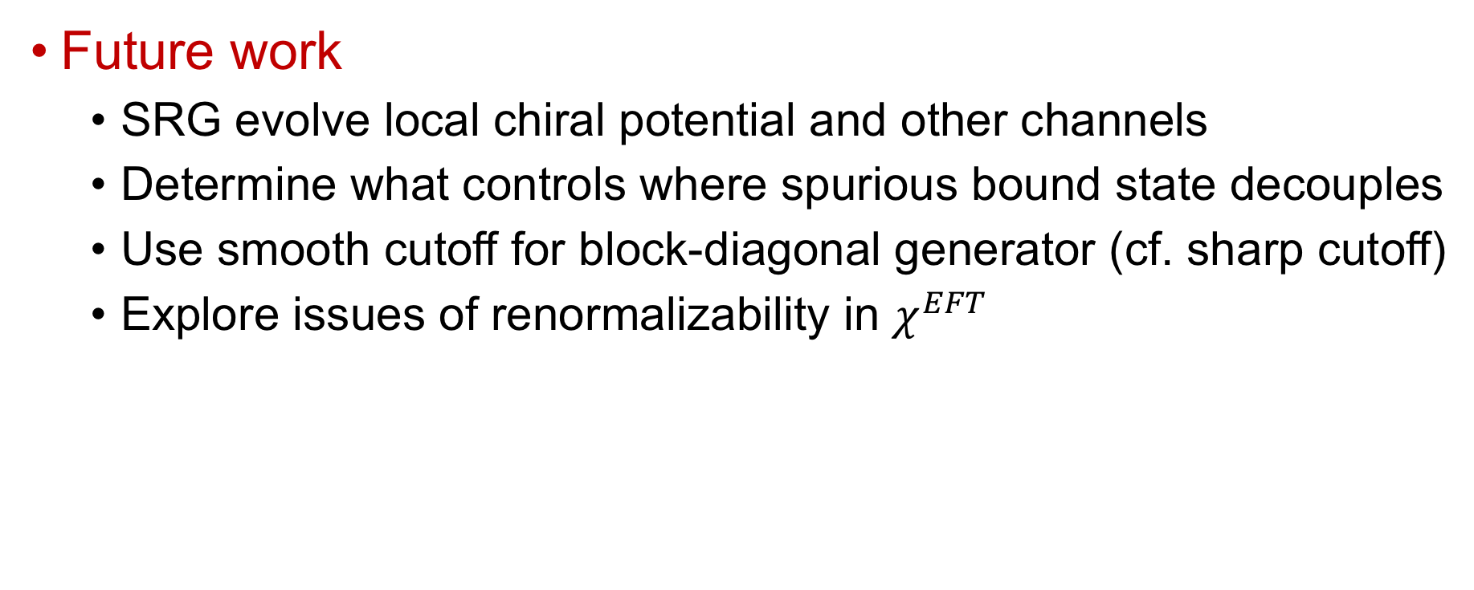
Conclusion
Future work
SRG evolve local chiral potential and other channels
Determine what controls where spurious bound state decouples
Use smooth cutoff for block-diagonal generator (cf. sharp cutoff)
Explore issues of renormalizability in $χ^{EFT}$

